Slide 1
Asynchronous I/O with Callback Programming

Slide 2
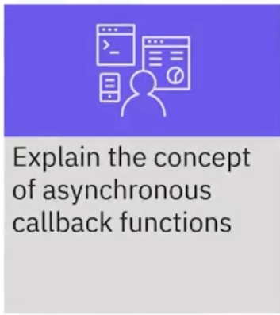

What will learn you

Slide 3

Asynchronous I/O
• Network operations run in an asynchronous
manner
• For example, the response from a web service
call might not return immediately
• When an application blocks (or waits) for a
network operation to complete, that
application wastes processing time on the
server

Slide 4
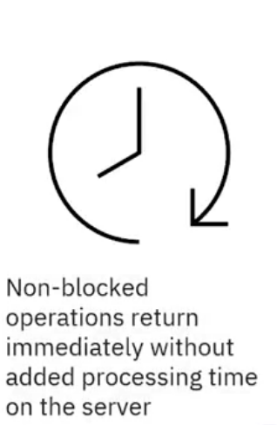
Asynchronous I/O
• Node.js makes all network operations in a non-
blocking manner
• Every network operation returns immediately
• To handle the result from a network call, you
can write a callback function that Node.js calls
when the network operation completes

Slide 5
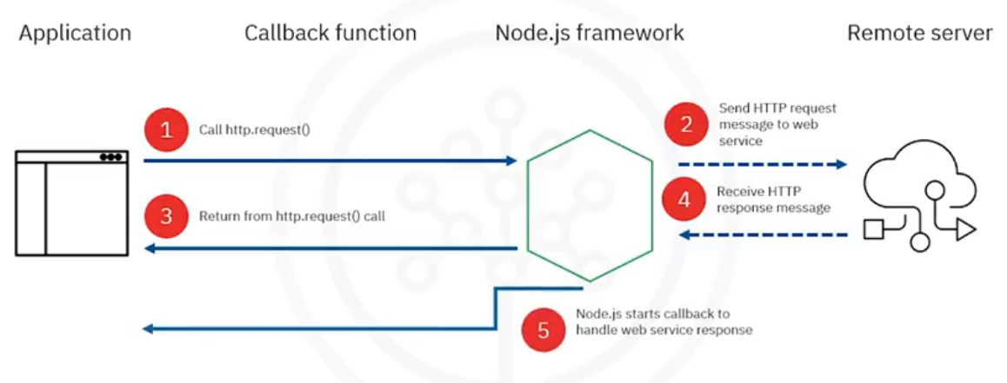
Application calls http.request()

Slide 6
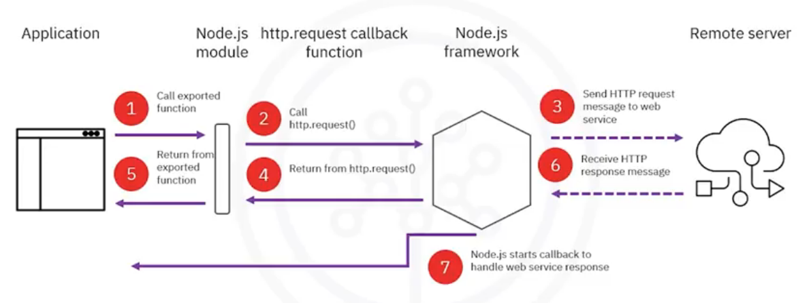
Node.js calls http.request()

Slide 7
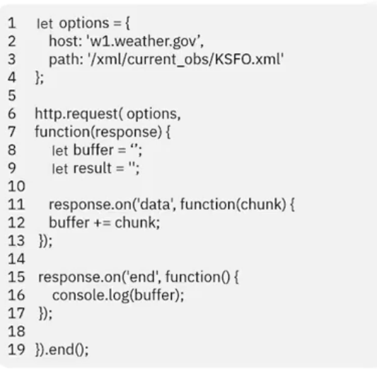
Example: sending an HTTP request
• When the Node.js module
calls this anonymous function,
events occur while receiving
parts of the HTTP response
message
• In the actual coding, we may
need to use https

Slide 8
http.request options and callback
• The http.request function calls the callback function
parameter when it receives part of the HTTP response
message
• The callback function parameter is optional; you can send an
HTTP request and disregard the response message (object)

Slide 9
http.request options and callback
• When http. request calls the callback function, it passes a
response object in the first parameter

Slide 10
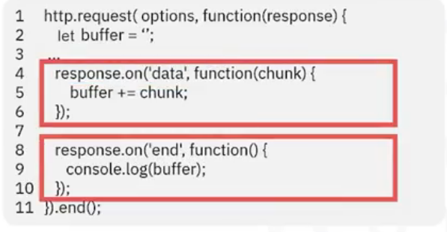
Handling response events
• The response object emits a datal event when Node.js
module receives a part of the HTTP response message
• When the Node.js module receives the last part of the
HTTP response message, the response object emits an
lend I event

Slide 11
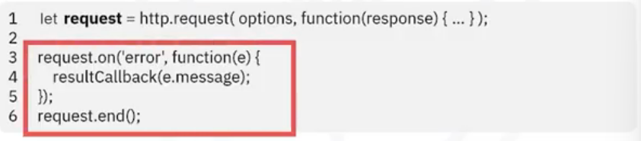
Handling error events
• If the request fails, there is an 'error' event followed by the
'close' event

Slide 12
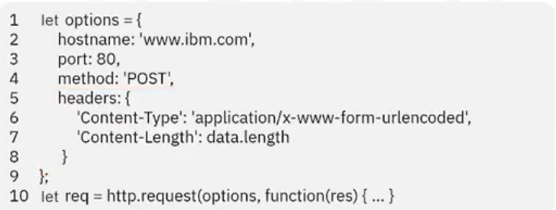
Handling error events
• With the http.clientRequest object, you can:
• Write data to the HTTP request message body
• Add headers to the HTTP request message
• Define an event handler for errors that Node.js encounters while
sending the request message

Slide 13
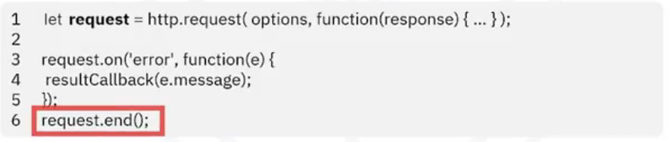
Handling error events
• Call clientRequest.end() to complete sending the request

Slide 14
Recap
In this video, you learned that:
• When an application blocks for a network operation to
complete, that application wastes processing time on the
• Node.js makes all network operations in a non-blocking manner
• When the Node.js framework receives an HTTP response
message from the remote server, it calls the callback function
that handles the HTTP response message

